Slide 1
Guide: Dr. M.CHAITANYA KISHORE REDDY, Prof & HOD
NRI INSTITUTE OF TECHNOLOGY
DEPARTMENT OF INFORMATION TECHNOLOGY
Project By:
K. Pradeep
A. Devi Priya
V. Luke Sundar

Slide 2
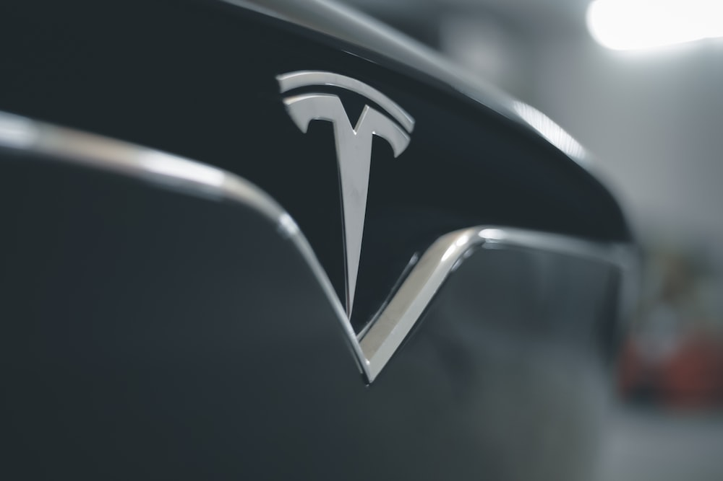
TESLA STOCK PRICE PREDICTION

Slide 3
AGENDA:
INTRODUCTION
PROBLEM STATEMENT
EXISTING SYSTEM
PROPOSED SYSTEM
SOFTWARE AND HARDWARE REQUIREMENTS
MODULES
ARCHITECTURE
TESTING
OUTPUT
CONCLUSION

Slide 4
INTRODUCTION:
An American car manufacturing company Tesla Inc was founded on 2003. It is one of the companies that developed electric cars to a manufacturing standard and made it available for the consumer market
Over the last two years few stocks have been most exciting and controversial as tesla. The company aims to change the world fundamentally by disrupting one of the essential industries.
Not only did it make lot of money for its investors tesla made Elon Musk into one of the most powerful CEO’s in the world. However, market participants are rightfully skeptical about how high the tesla stock can go.
Tesla just reported its production and delivery numbers for Q3 2020.the company produced 237,000 vehicles while it has delivered 241,000 vehicles these numbers bring it close to the annual production volume of 1 million units

Slide 5
PROBLEM STATEMENT:
Our project is focused on Tesla Stock Price Prediction.
In our project stock prices are predicted using Machine Learning Algorithms (Linear Regression)

Slide 6
EXISTING SYSTEM:
Here, We have reviewed various approaches for Tesla Stock Price Prediction.
All approaches have their own advantages and disadvantages.
CNN & LSTM is a most popular algorithm to predict the tesla stock price but there are some challenges in this method like use to need a lot of training data, High computational cost, without GPU data quite slow to train, depend on any previous information for prediction.

Slide 7
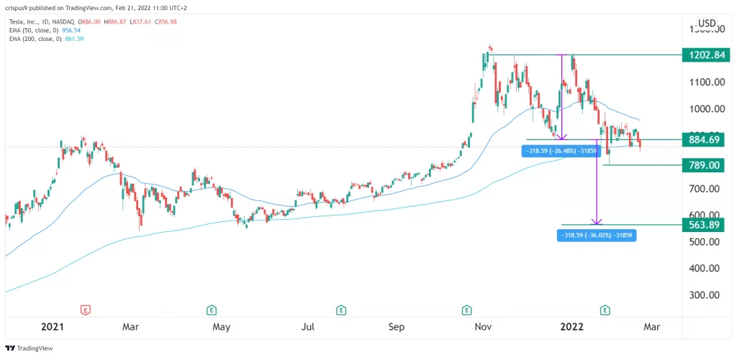
PROPOSED SYSTEM:
In this an attempt is made to predict the stock market trend using a culmination of predictive modelling and regression algorithms.
This model takes the current stock values from the data sets gathered. The data gathered is modelled into various sub parts or data sets which is used to train and test the algorithm.
Then, regression models in Python or R is used to model the data. This model runs a comprehensive search algorithm on the data sets and create a summary table based on the output. The values are plot on a chart and regression and clustering techniques are applied to find out the increase or decrease in price of that stock.
Based on the calculation, this model extrapolates the current stock prices to generate a prediction after a given time. The models are built and trained using supervised machine learning algorithms. The output will be in graphical form and will change with change in dataset.
This model expects up to 69% of in-sample accuracy and 37% or out-of-sample accuracy using supervised ML algorithms.

Slide 8
HARDWARE REQUIREMENTS:
PROCESSOR: INTEL P4 PROCESSOR
PROCESSOR SPEED: 2 GHz
RAM: 4GB
HARD DISK: 500 MB

Slide 9
SOFTWARE REQUIREMENTS:
OPERATING SYSTEM: WINDOWS 10
CODING LAGUAGE: PYTHON
TOOLS: PANDAS, NUMPY, MATPLOTLIB, SKLEARN
PLATFORM/WEB SERVER: JUPYTER NOTEBOOK
TECHNOLOGY: MACHINE LEARNING

Slide 10
MODULES:
Collection of Data Set:
We have collected the data from Kaggle.
Hypothesis Generation:
It contains open, high, low, close, volume.
Data Cleaning:
In this missing values are identified and they are filled with some parameters and at the same time unwanted data is removed.
Splitting the data into train and test and model fitting:
We need to split the data into train data and test data. The perform model fitting for the following Algorithm.
Linear Regression:
Linear Regression is a ML based algorithm on supervised learning. It is used to analyze two separate variables to define a single relationship and is a useful measure for technical and quantitative analysis in financial markets

Slide 11
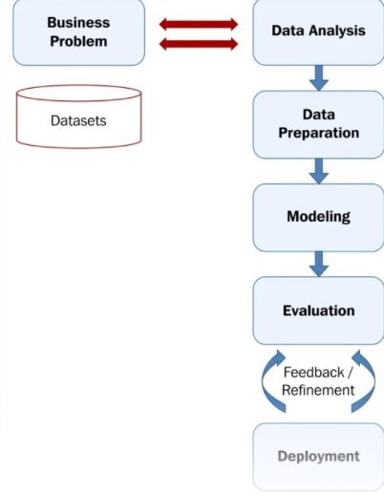
ARCHITECTURE:

Slide 12
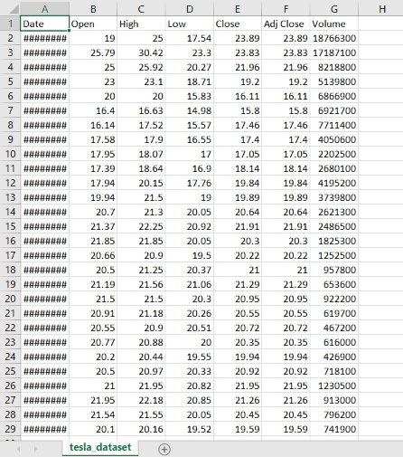
TEST AND OUTPUT:
DATA SET:

Slide 13
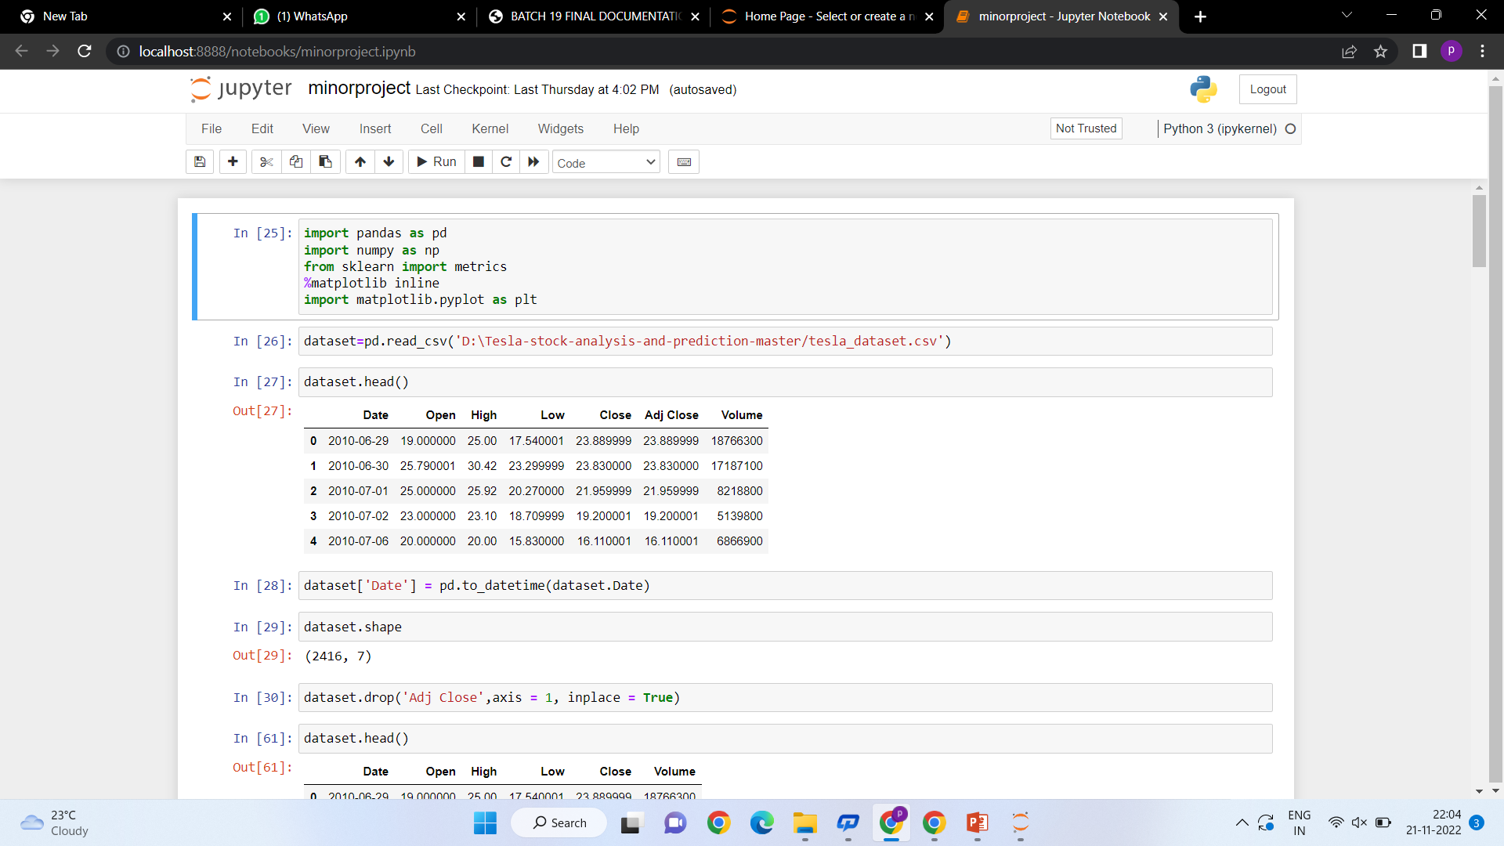
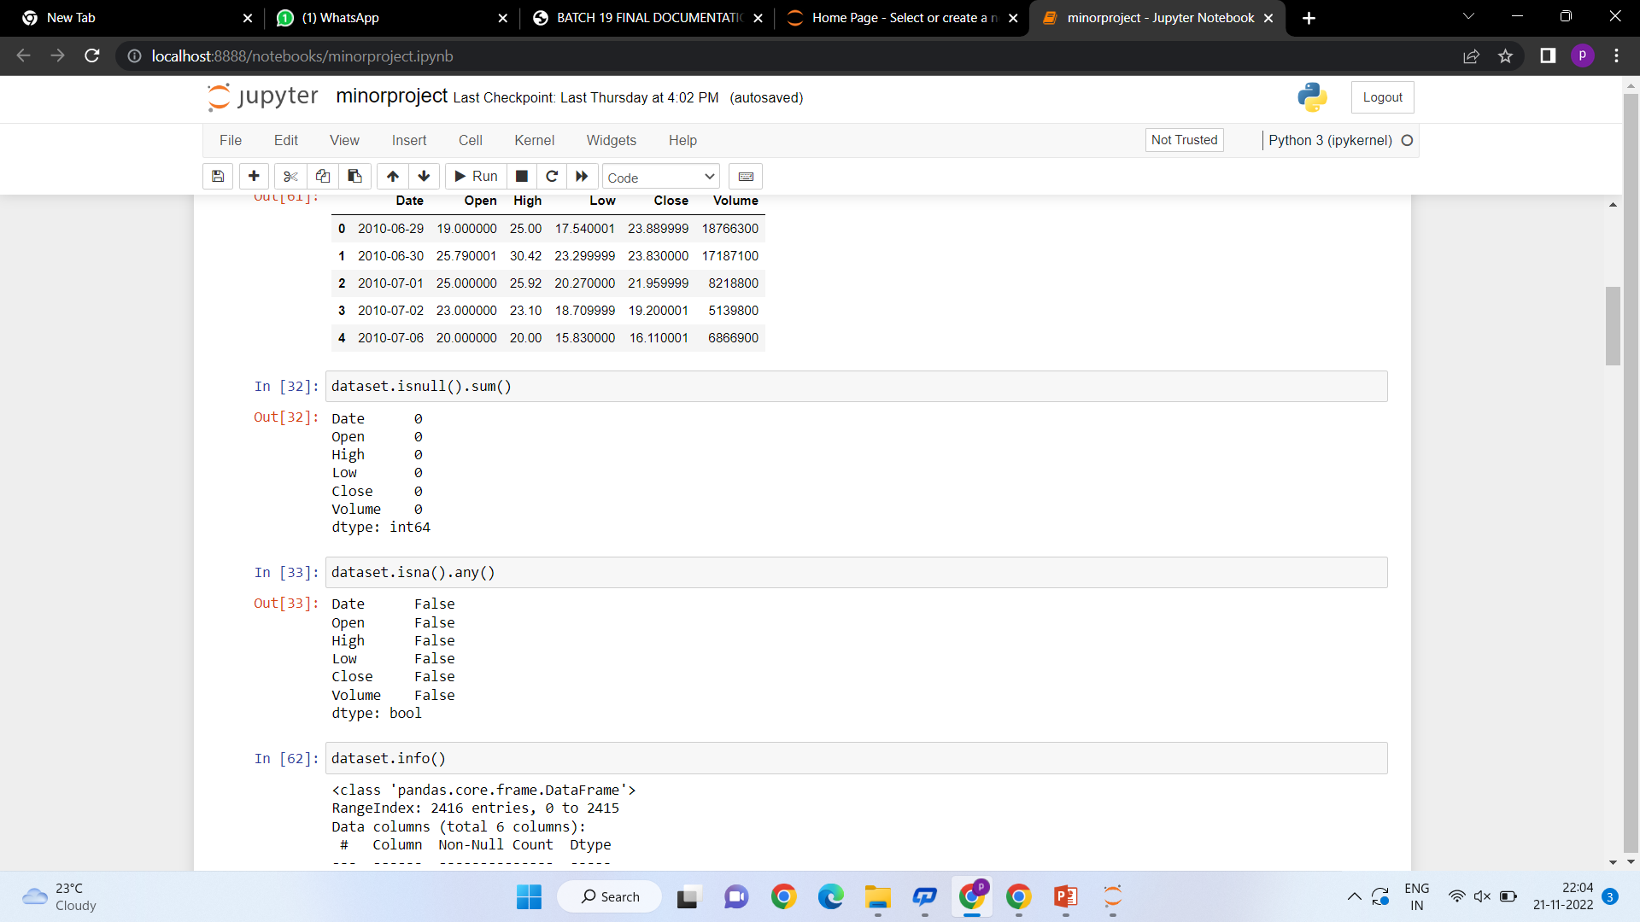
CODING:

Slide 14
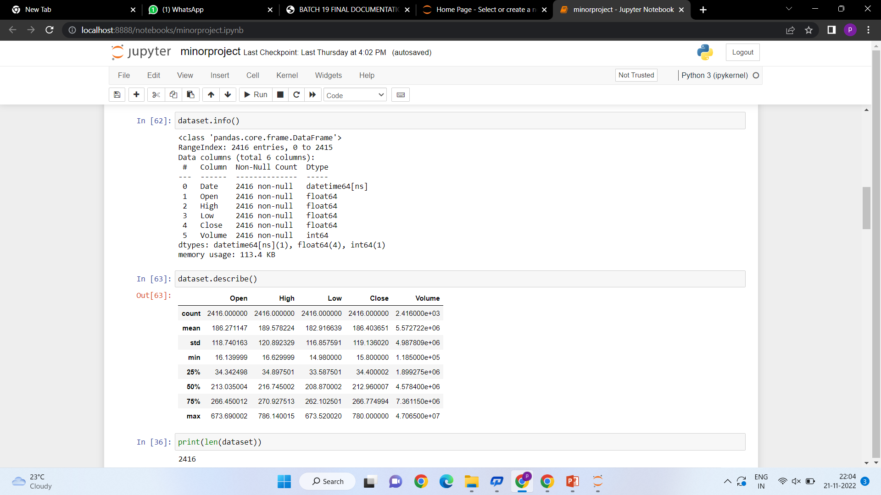
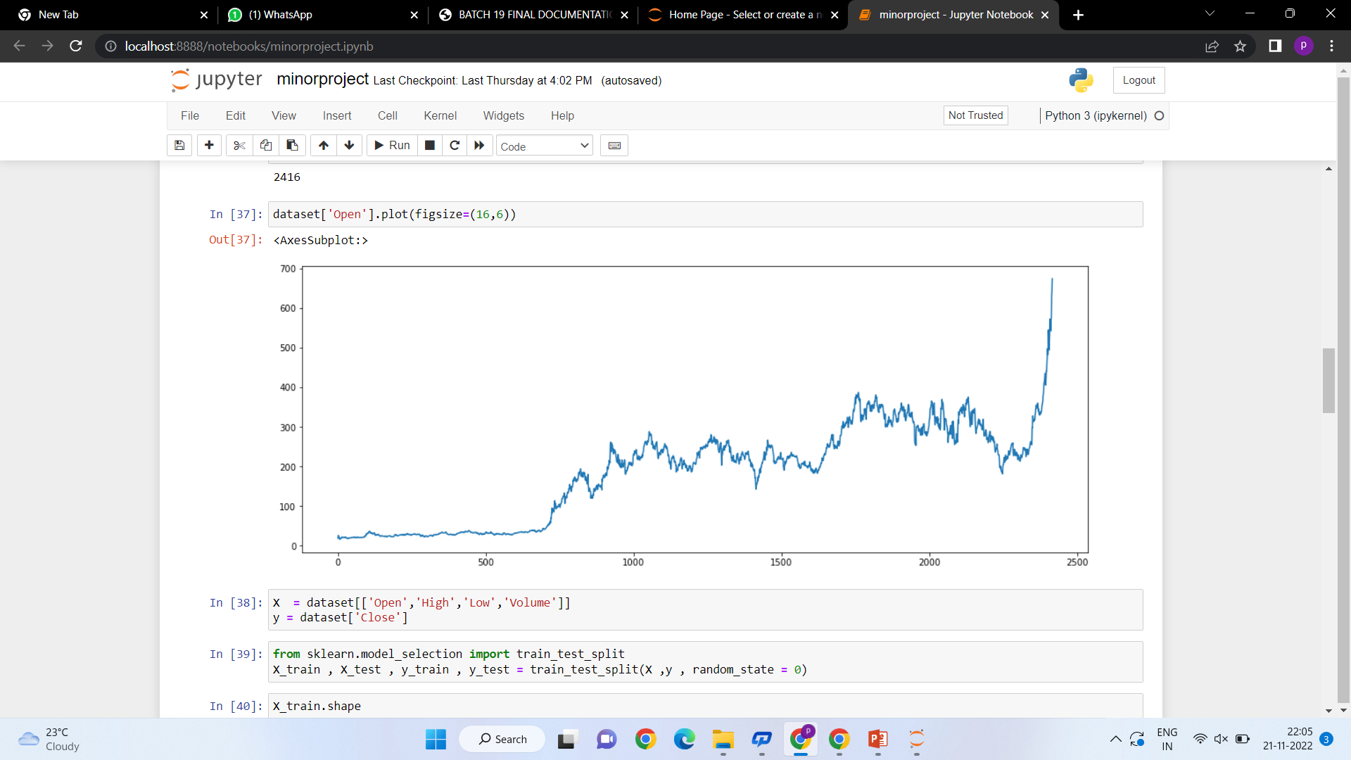
CODING:

Slide 15
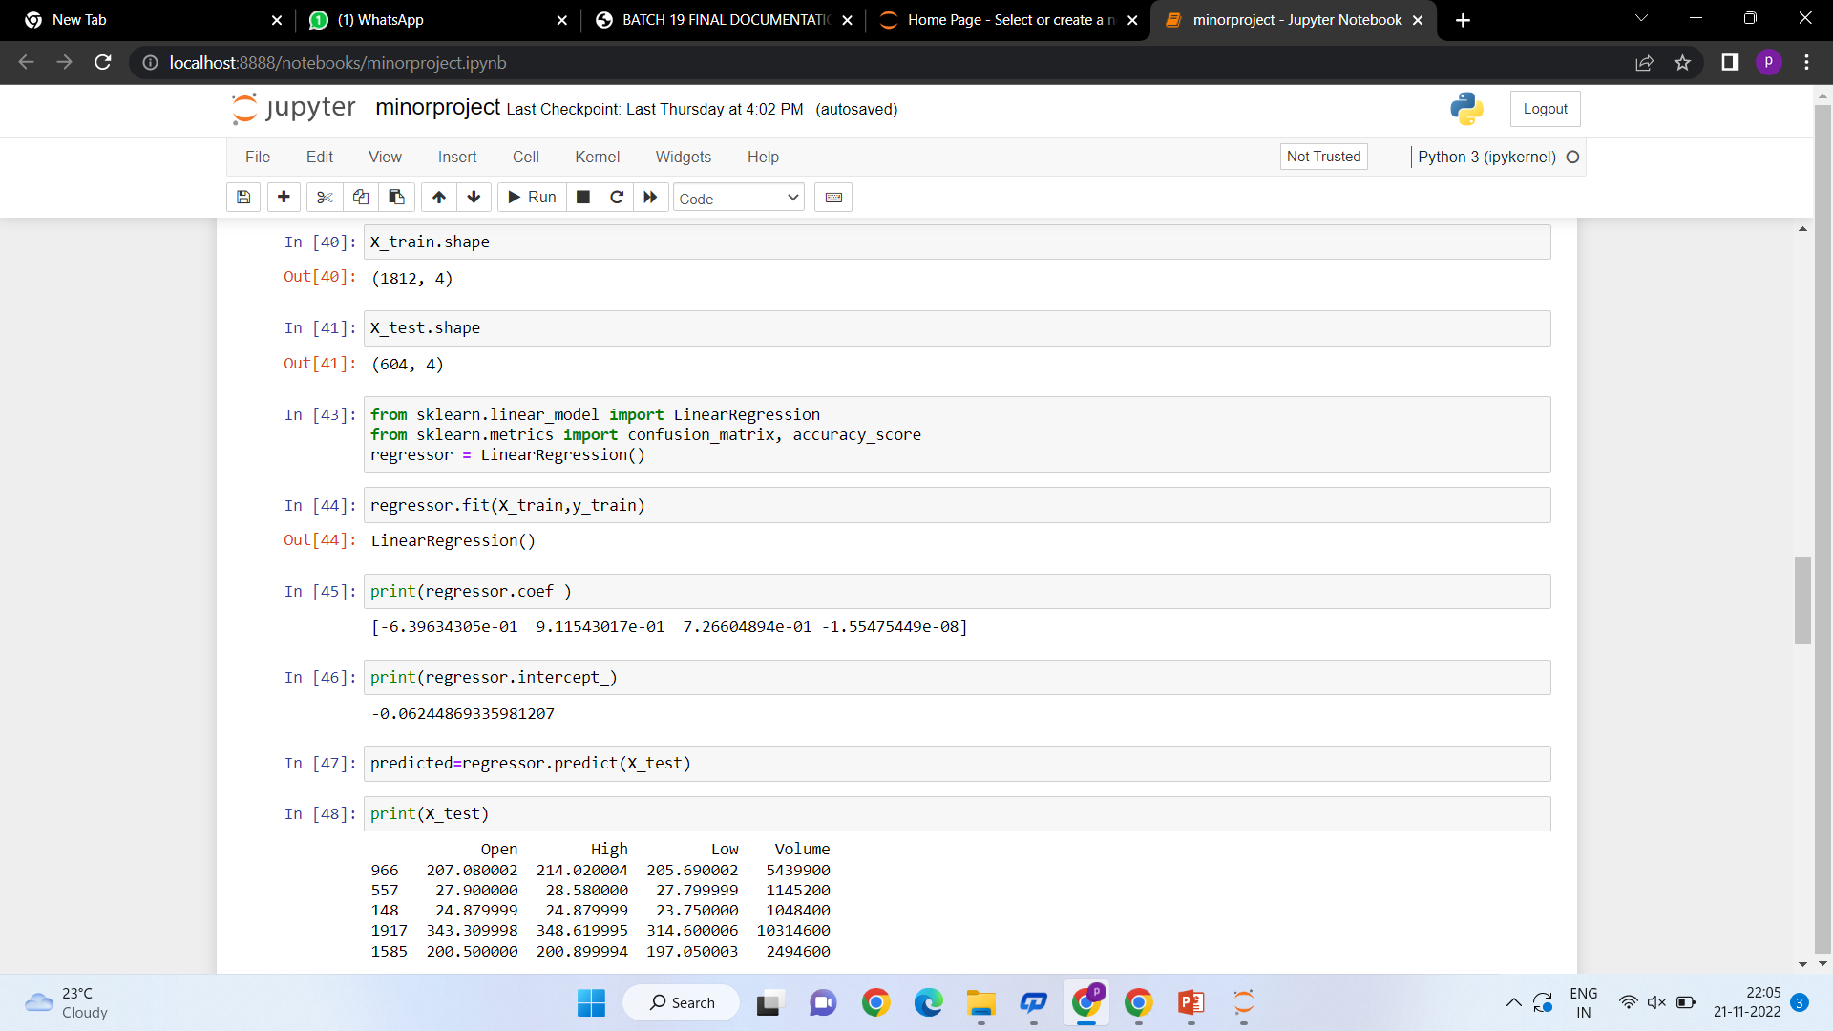
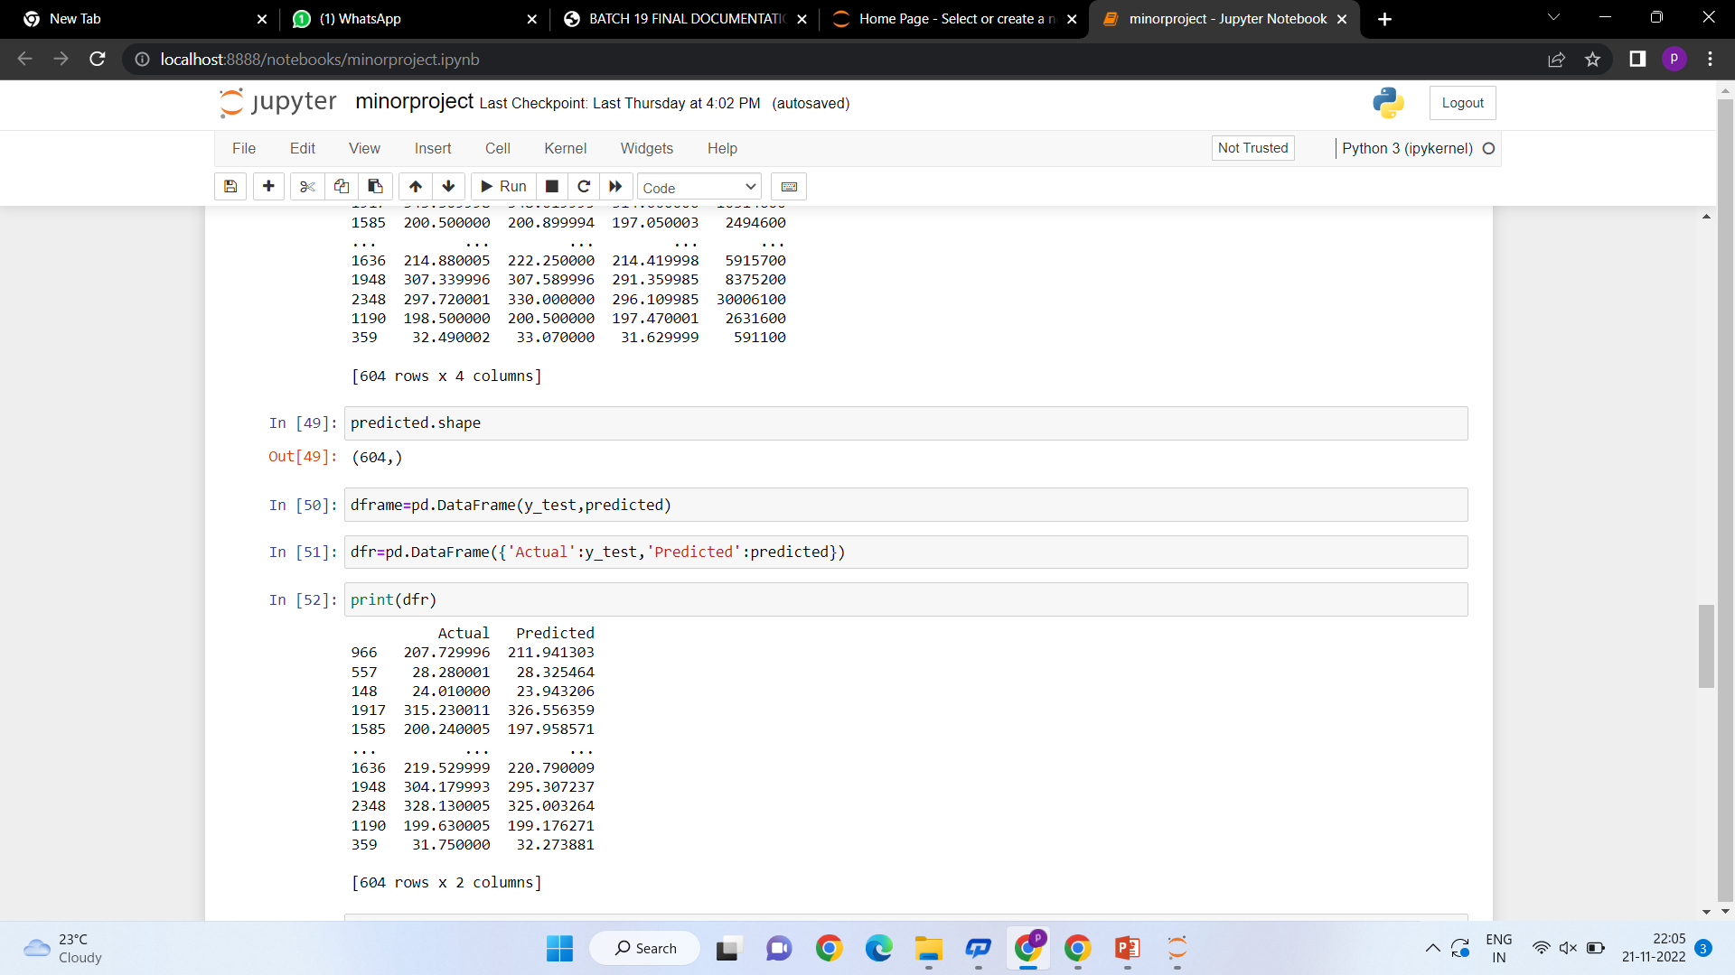
CODING:

Slide 16
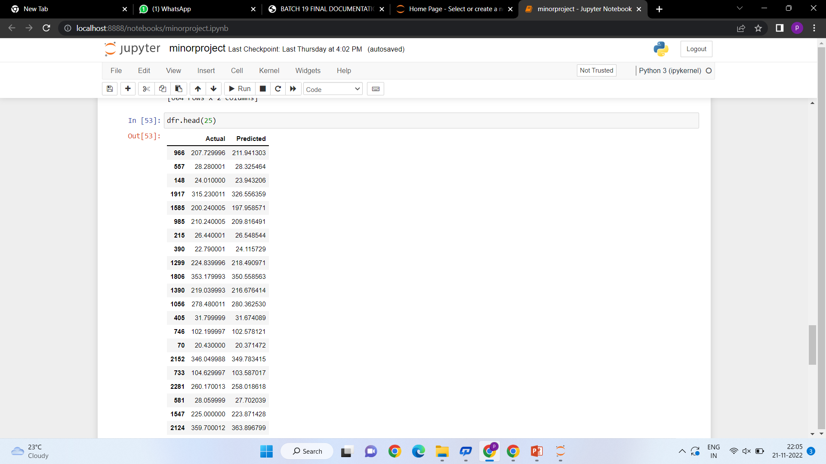
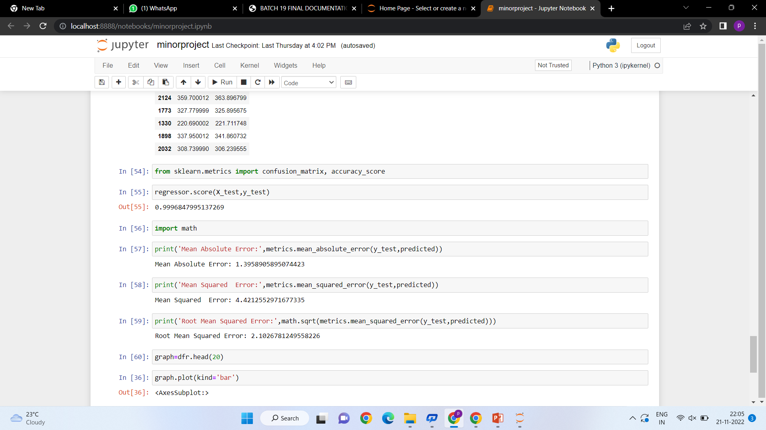
CODING:

Slide 17
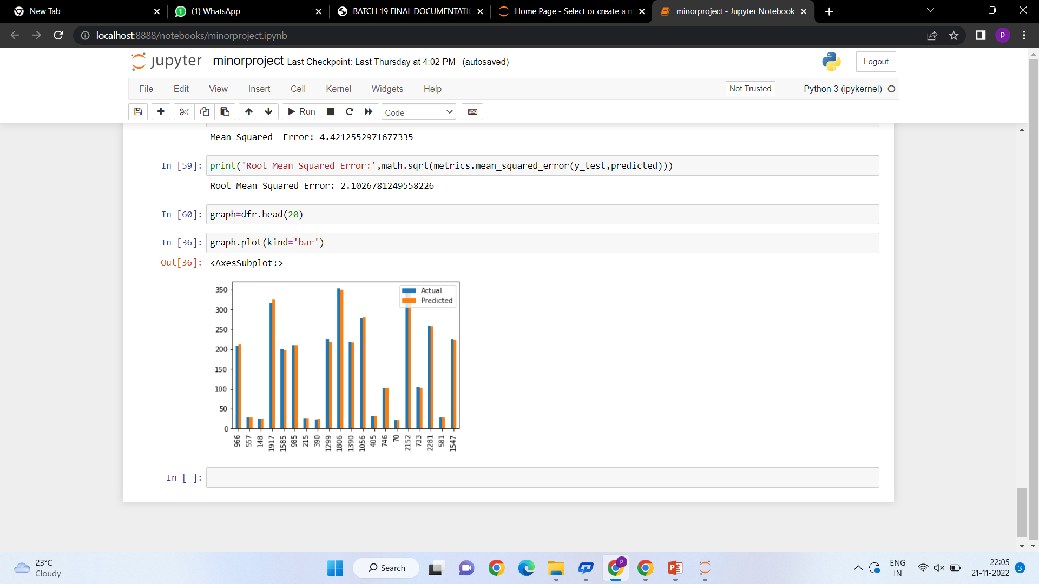
CODING:

Slide 18
CONCLUSION:
It seems like Tesla’s stock prices will decrease in the coming future if they don’t come up with a new idea of representing their vision. This may be possible as other companies have also started manufacturing electric vehicles at a very low price as compared to Tesla.
The successful prediction of a stock's future price will maximize investor’s gains.

